Slide 1
MyPass
CIS 476
Term Project
Brandon Bailey and
Andrew Gross

Slide 2
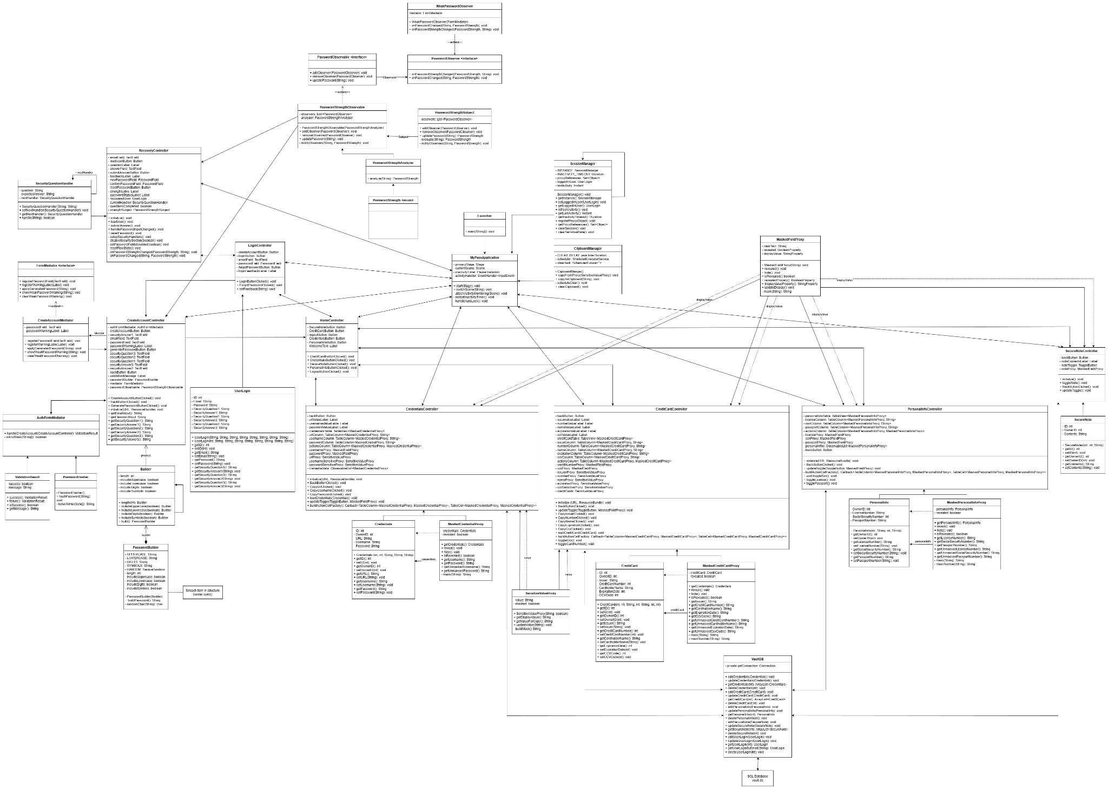
C
L
A
S
S
D
I
A
G
R
A
M

Slide 3
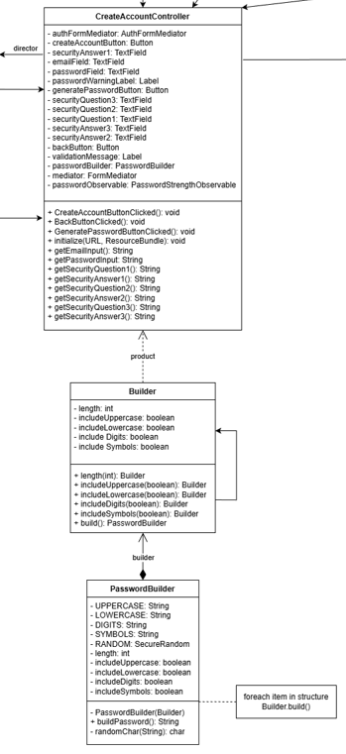
Builder - Configurable Password Generation
Class: PasswordBuilder
What it does: Uses a nested Builder to toggle uppercase/lowercase/digits/symbols and set length, then constructs a password with required characters and shuffles the result
How it’s used: CreateAccountController instantiates a PasswordBuilder and calls buildPassword() when the “Generate Password” button is clicked, then forwards the result to the UI mediator and observers
  Implementation: PasswordBuilder setup, pool assembly, and nested Builder setters (Lines 7-123 of PasswordBuilder.java)
  Usage in controller: generation and dispatch to mediator/observer pipeline (Lines 43-89 of CreateAccountController.java)

Slide 4
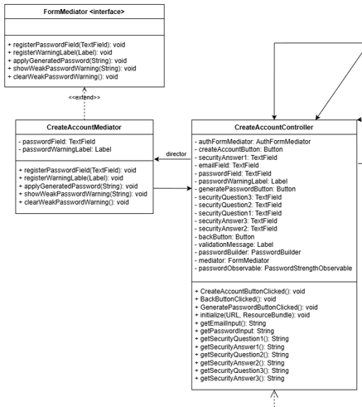
Mediator — Centralized Form Coordination
Classes: FormMediator (interface) and CreateAccountMediator
What it does: Mediates interactions between UI elements (password field and warning label) so controllers don’t manipulate data directly
How it’s used: CreateAccountController registers its fields with the mediator, then calls mediator methods to apply generated passwords and display/clear weak-password warnings
  Mediator contract and methods
    Lines 6-15 of FormMediator.java
  Concrete mediator updating controls
    Lines 6-42 of CreateAccountMediator.java
  Controller wiring mediator to UI elements
    Lines 14-89 of CreateAccountController.java

Slide 5
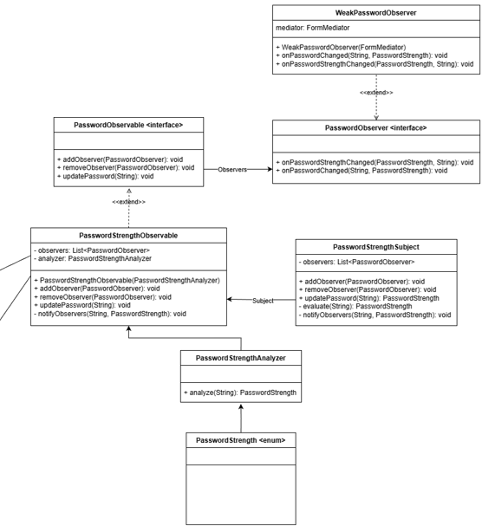
Observer — Live Password-Strength Feedback
Classes: PasswordObservable (interface), PasswordStrengthObservable, PasswordStrengthSubject, observers like WeakPasswordObserver and RecoveryController
What it does: Observables evaluate password strength and notify observers, which react (show warnings or enable buttons)
How it’s used:
  In account creation, PasswordStrengthObservable analyzes input and notifies WeakPasswordObserver, which asks the mediator to show/hide warnings
    Lines 6-35 of PasswordStrengthObservable.java
    Lines 7-35 of WeakPasswordObserver.java
  In password recovery, PasswordStrengthSubject evaluates strength and notifies RecoveryController to update status labels and gating logic before enabling reset
    Lines 6-95 of PasswordStrengthSubject.java
    Lines 38-188 of RecoveryController.java

Slide 6
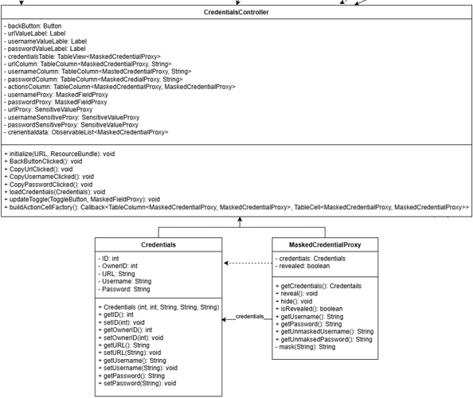
Proxy — Controlled Exposure of Sensitive Data
Classes: SensitiveValueProxy, MaskedCredentialProxy
What it does: Wraps sensitive fields so the UI can show masked text by default, while allowing unmasked retrieval when explicitly revealed
How it’s used: Proxies return masked display strings until reveal() is called, letting controllers safely bind them to views without leaking raw secrets
  Generic sensitive-value masking logic
    Lines 5-35 of SensitiveValueProxy.java
  Credential masking with reveal/hide toggles and per-field masking rules
    Lines 3-59 of MaskedCredentialProxy.java

Slide 7
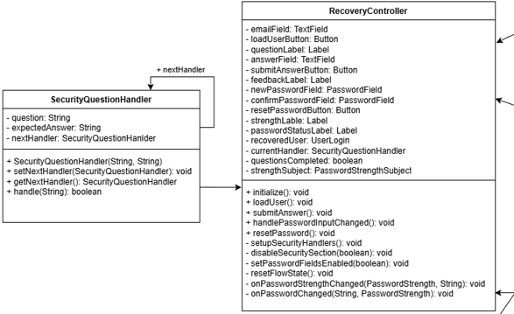
Chain of Responsibility — Sequential Security Question Checks
Classes: SecurityQuestionHandler linked via setNextHandler, orchestrated by RecoveryController
What it does: Each handler validates one security question/answer and passes control to the next until all are answered
How it’s used: RecoveryController builds a chain of three handlers; submitAnswer() advances through the chain and only unlocks password reset when all handlers have approved answers
  Lines 3-30 of SecurityQuestionHandler.java
  Lines 24-149 of RecoveryController.java

Slide 8
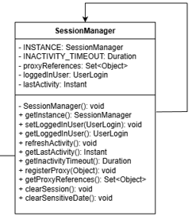
Singleton — Shared Session State
Class: SessionManager
What it does: Ensures a single, shared session object that tracks the logged-in user and manages sensitive cleanup/clipboard clearing
How it’s used: Accessed via SessionManager.getInstance(); controllers store and clear session data through synchronized setters/getters and clearSession()
  Singleton instance, accessor, and session cleanup logic
    Lines 7-48 of SessionManager.java

Slide 9
Linking the Pieces
Account creation flow: CreateAccountController → generates password via Builder, hands it to Mediator to populate the field, and pushes it through Observer to warn on weak passwords
  Lines 43-89 of CreateAccountController.java
  Lines 7-123 of PasswordBuilder.java
  Lines 6-42 of CreateAccountMediator.java
Data display flow: Controllers wrap entities in Proxy classes (e.g., credentials) so UI bindings show masked values until a user action reveals them
  Lines 3-59 of MaskedCredentialProxy.java
Recovery flow: RecoveryController chains SecurityQuestionHandler objects (Chain of Responsibility) and, once cleared, relies on Observer feedback to gate password reset; session data is centralized in the Singleton SessionManager and sensitive remnants are cleared there
  Lines 34-188 of RecoveryController.java
  Lines 7-48 of SessionManager.java

Slide 10
C
L
A
S
S
D
I
A
G
R
A
M
Chain of Responsibility
Singleton
Mediator
Observer
Proxy
Builder

Slide 11
Task Summary
Functions/Features
Allow user to register an account (email address as username and a master password and three security questions) Brandon and Andrew
Suggest strong password (password generator) Andrew
Weak master password warning. Brandon and Andrew
Once logs in, the user will have access to all sensitive data saved in the vault. Brandon
MyPass has built-in data type in the vault, including Login, Credit Card, Identity, Secure Notes. Brandon
MyPass allows user to create/modify/delete items in the vault. Brandon
MyPass allows user to easily copy username/password and URL in Login data type. Andrew
MyPass allows user to easily copy credit card number and CVV in credit card data type. Andrew
Sensitive data such as username, password, credit card number, CVV, passport number, license number, social security number must be masked. Andrew
All masked data must be given an option to unmask. Brandon and Andrew
Auto lock after x mins of inactivity. Andrew
Auto delete copied sensitive data in clipboard after x mins. Andrew

Slide 12
Task Summary
Implementation:
User Authentication and Encryption: Andrew
  Implement the Singleton pattern to manage the user's session securely.
Password Storage and Management: Andrew
  Apply the Observer pattern to notify users in the events of weak password.
User Interface and Interaction: Brandon
  Implement the Mediator pattern to manage communication between various UI components.
Password Generation: Andrew
  Apply the Builder pattern to create complex passwords with specific requirements (length, complexity).
Data Mask and Unmask: Andrew
  Implement the Proxy pattern to mask and unmask sensitive data.
Master Password Recovery: Brandon
  Apply the Chain of Responsibility pattern to create a secure process (using three security questions to build the chain) for recovering a forgotten master password.

